Slide 1
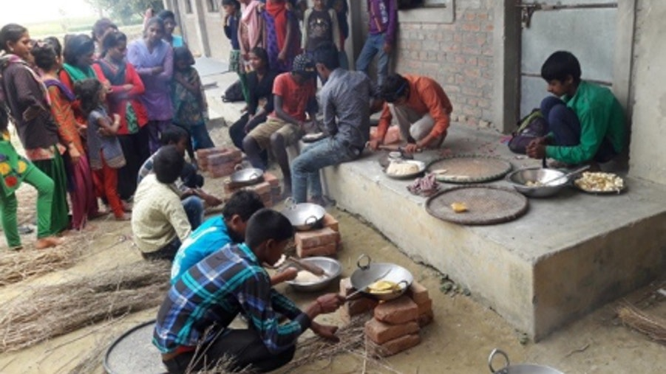
What is happening here?
Notes:
Experiencing a new situation
Changing gender expectations / Publicly, at school
Changing behavior BECAUSE changing expectations what OTHERS expect

Slide 2
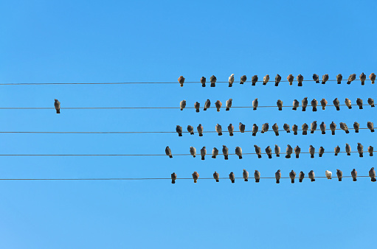
The magic of the others
one experiment – one question – one encouradgment

Slide 3
One experiment
Failed inclusion is costly for everyone
Dilemma 1:
vote to Include or exclude
A “costly” indivual
Dilemma 2:
Cooperate or freeride in the group selected by voting
Van der Zandt & Vyrastekova, 2019
Notes:
Vertle wat s samewerking
Positive spillovers, asl basisporbeelm voor onze social e samenwerking
Wat ik doe beinvloed andere, geen mens is een eiland

Slide 4
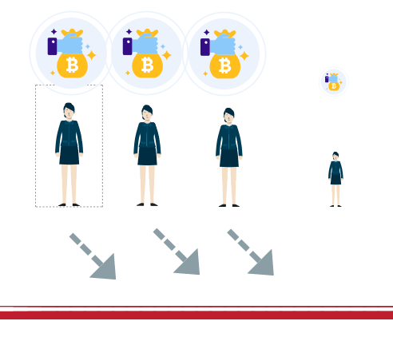
Dilemma 1: vote to Include or exclude A “costly” indivual

Slide 5
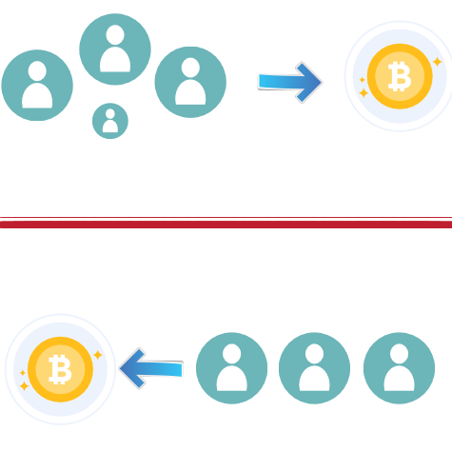
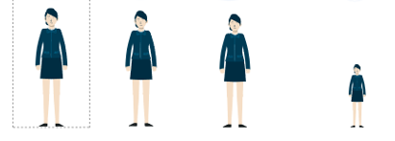
Dilemma 2:
Cooperate or freeride in the group selected by voting

Slide 6
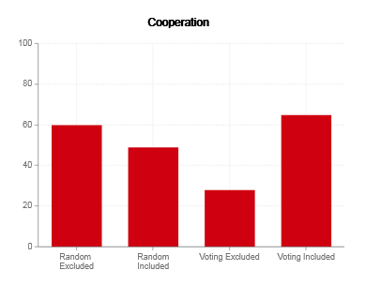

Groups that include the “unproductive” individual cooperate better and produce higher welfare for all
Notes:
It is not per se over the positive impact of what happens if we include, but the negative one – what happens if we exclude!

Slide 7
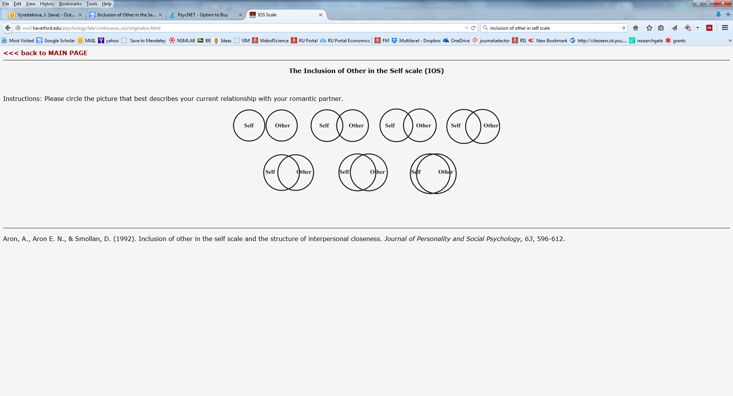
One question
Does inclusion hurt the “included” kids?
Vyrastekova, J. (2021). Social inclusion of students with special educational needs assessed by the Inclusion of Other in the Self scale. PLoS ONE, 1–17.
Notes:
Vertle wat s samewerking
Positive spillovers, asl basisporbeelm voor onze social e samenwerking
Wat ik doe beinvloed andere, geen mens is een eiland

Slide 8
Regular or special?
Convention of the Rights of Persons with Disabilities CRPD (UN 2006)
Art. 24(2b): “Persons with disabilities can access an inclusive, quality and free primary education and secondary education on an equal basis with others in the communities in which they live.”
Notes:
Disputed because SEN students attending regular schools
are more lonely (Langher et al. 2010; Pijl, Skaalvik, & Skaalvik, 2010),
have fewer friends and less interactions with peers (Koster et al., 2009; Pijl, Frostad, & Flem, 2008), less accepted (Jones & Frederickson, 2010)
experience less social participation (Schwab, Gebhardt, Krammer, & Gasteiger-Klicpera, 2015).; Avramidis et al. (2017) summarize such findings across multiple national school systems (UK, Canada, Spain, US, Norway, Netherlands etc.)
Based on comparisons of SEN to non-SEN students and sociometrics data (peer nominations; peer ratings) with a strong focus on reciprocity built into the social contact evaluation.
The contribution of this study is twofold

Slide 9
Not regular, not special: INCLUSIVE!
SEN students at regular schools…
are more likely to have more than one friend, and their friends liver closer to them
do not feel more lonely than those at special schools
have perception of inclusion explained by the school’s inclusive characteristics, not by the “type” of the school.

Slide 10

One encouradgment
Van der Zandt & Vyrastekova, 2019
Distortion of teachers’ second order beliefs about inclusive education (Vyrastekova, 2021)

Slide 11
What we think that others think matters
Inclusion is a nice ideal but impossible in practice.
Inclusion is not for everybody.
Some children are better off at another school, with other kids like them.
Notes:
Social norms
= behaviors associated with a specific group and context
conditional on expectations of others’ compliance with the behaviors,
enforced by disapproval/sanctioning of miscompliance,
stabilized by empirical and normative beliefs (Bicchieri 2007, 2009, 2011)
Empirical expectations
What we see others do
Normative expectations
What we believe is the right thing to do
Important! When in conflict, it’s what we see that drives behavior.

Slide 12
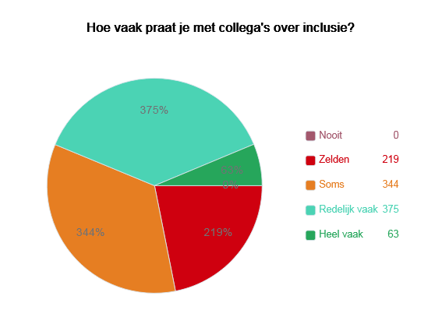
Inclusion expectations are often undiscussed at workplace
About 57% of teachers rarely or only sometimes discuss inclusion at own workplace.
While talking inclusion matters…
Notes:
N=24

Slide 13
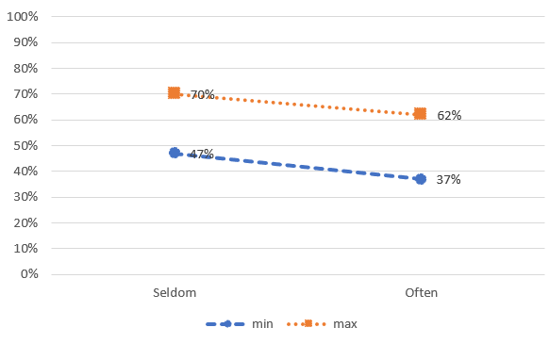
Inclusie klinkt mooi maar het is in de praktijk niet te doen
Minimaal/maximaal ...% van alle leraren eens
when discussing inclusion at workplace often or not often.
Notes:
Beliefs about others
are affected by discussing/
not discussing inclusion
at workplace –
“taboo” associated with more
pessimistic beliefs about others

Slide 14
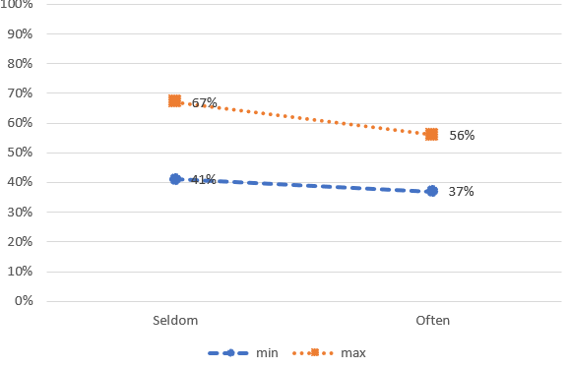
Inclusie gaat ten koste van gewone kinderen
Minimaal/maximaal ...% van alle leraren eens
when discussing inclusion at workplace often or not often.

Slide 15
Inclusion in education as a new norm
When empirical and normative beliefs are in conflict,
people do what they see others do… rather than
what they believe is the right thing to do.
When normative beliefs are not discussed,
people may hold distorted beliefs about others.
“Talk & walk the talk, to change the norm.”

Slide 16
The magic of the others
one experiment (inclusion matters)
one question (inclusive schools increase inclusion)
one encouradgment (talking inclusion changes what is possible)

Slide 17
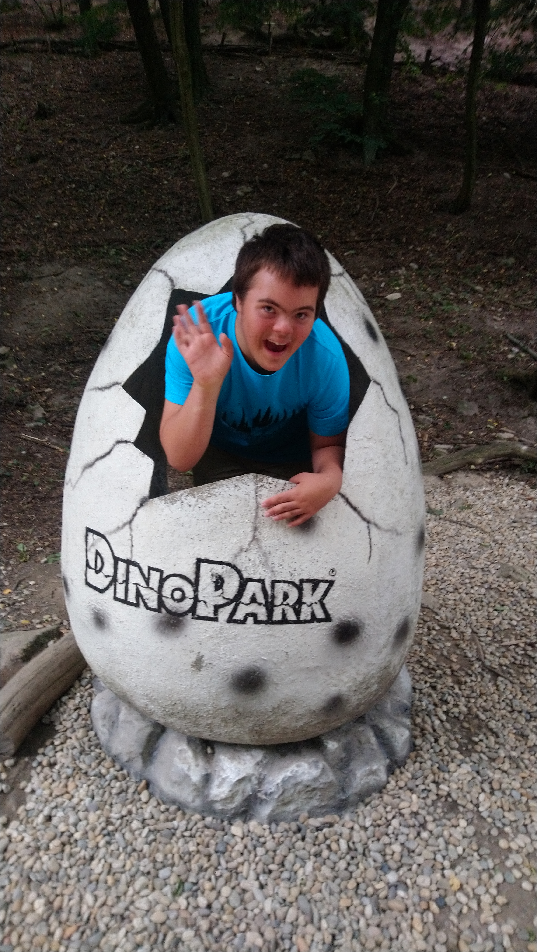
Thank you for your attention!
Questions?
You can reach me at:
Jana.Vyrastekova@ru.nl

Slide 18
Large-scale studies on inclusion impacts
Inclusie gaat ten koste van gewone kinderen.
inclusieve scholen ondersteunen betere cognitieve prestaties van leerlingen zonder extra ondersteuningsbehoefte (SEN) , zoals aangetoond op basis van 47 onderzoeken met in totaal bijna 5 milljon leerlingen
Szumski et al 2017 Educational Research Review
gebaseerd op bijna 12.000 leerlingen met extra ondersteuningsbehoefte, laat zien dat deze leerlingen betere cognitieve resultaten behalen in regulier onderwijs
Leerlingen met een beperking worden niet echt geaccepteerd en worden mogelijk gepest
reguliere scholen beter zijn in de sociale inclusie van SEN leerlingen te ondersteunen. De perceptie van sociale inclusie gaat samen met meer vriendschappen, en is gerelateerd aan inclusieve kenmerken van de scholen, die vooral bij reguliere scholen te vinden zijn.
Vyrastekova 2021 PlosONE
Inclusie is wel goed, maar niet voor iedere kind.
Kramer et al 2021 Review of Educational Research

Slide 19
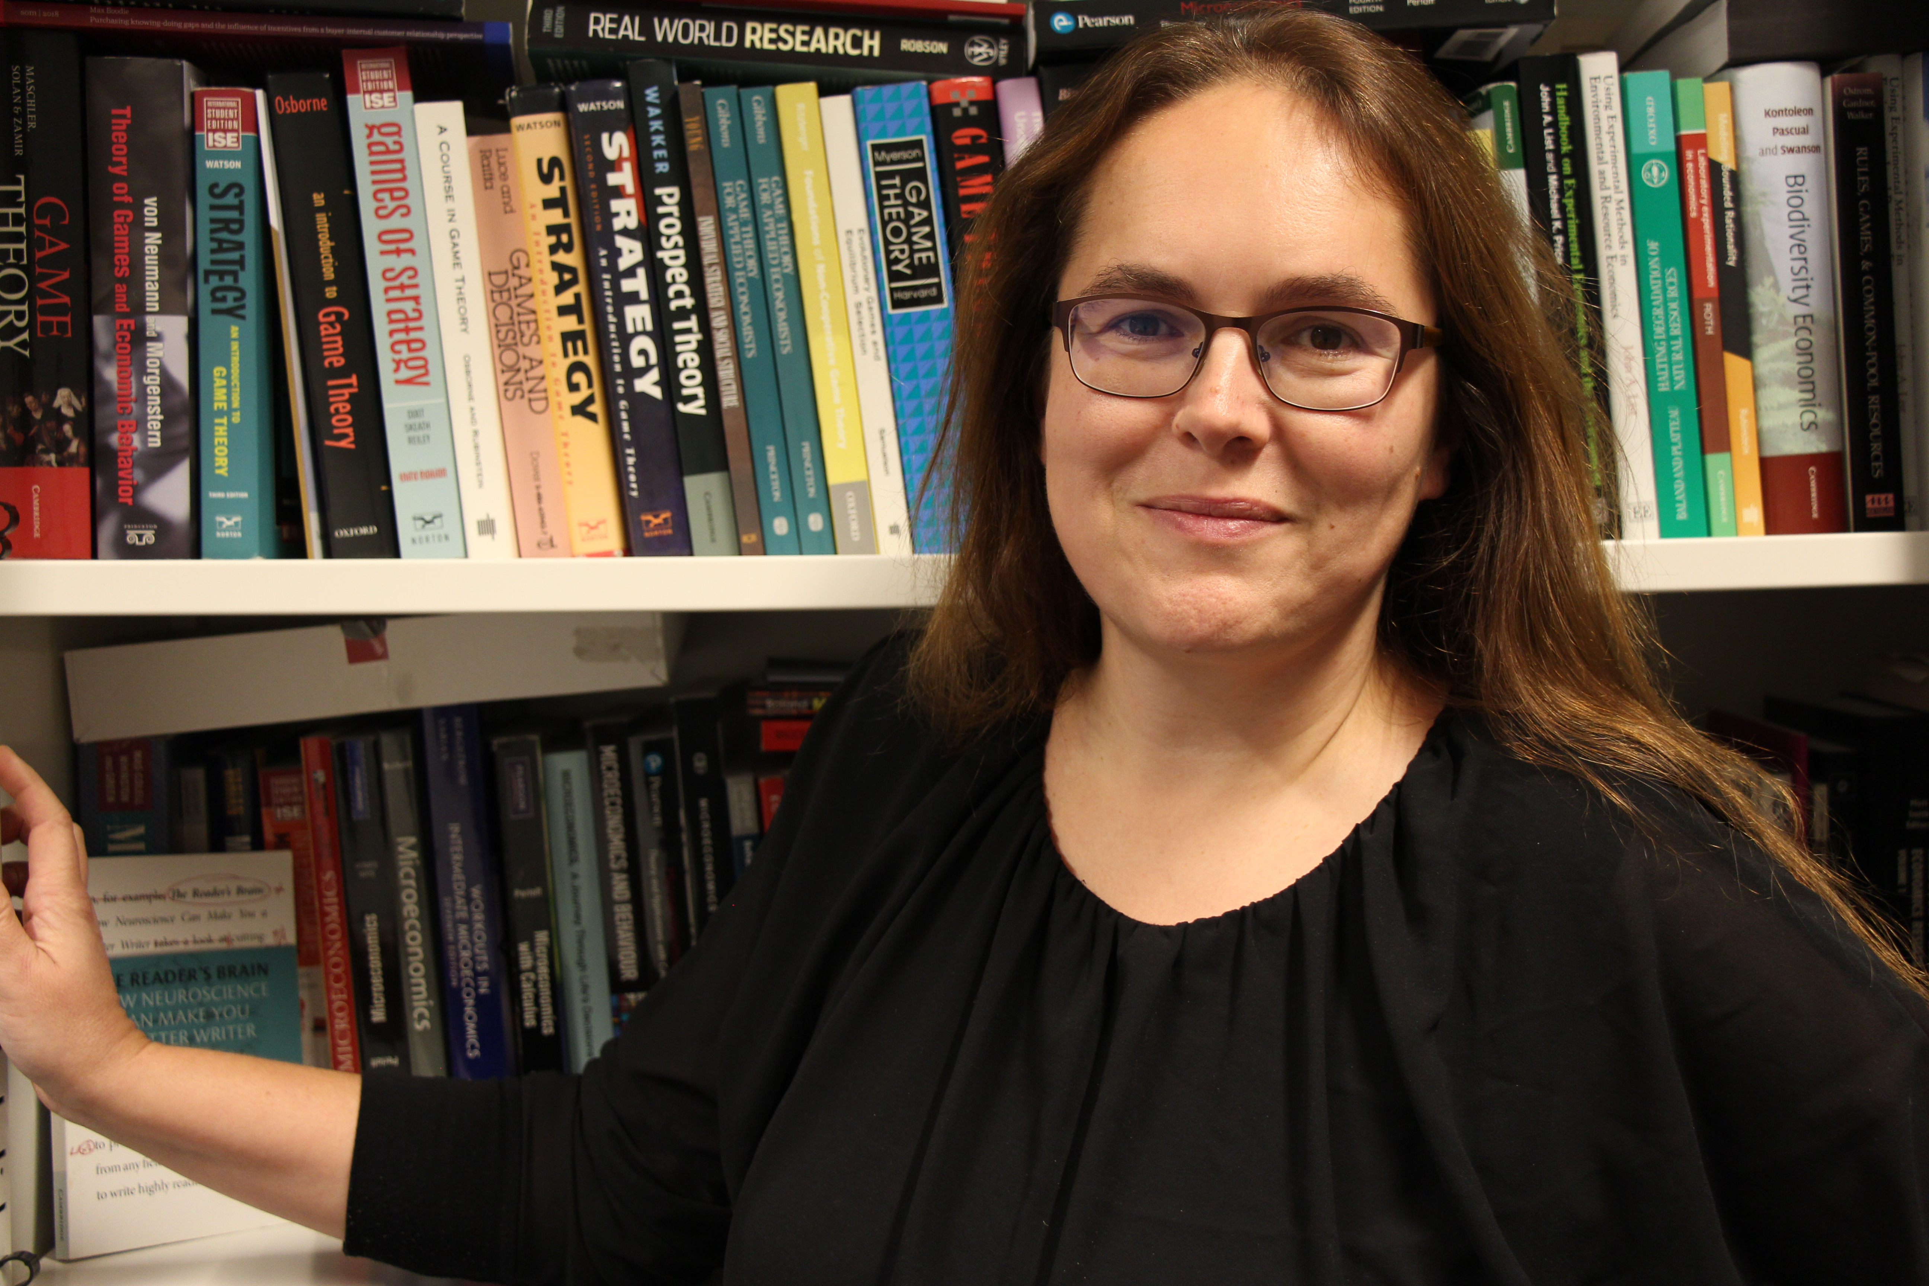
Dr. Jana Vyrastekova
Associate Professor in Economics, Policy & Behaviour
Experimental and behavioural economist
Department of Economics
Radboud University, Nijmegen

